Slide 1
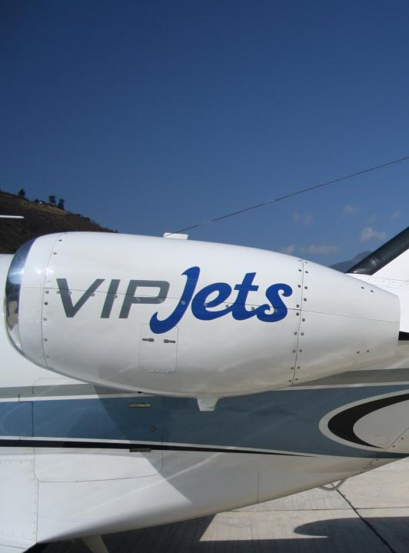
Medevac Services
9th Floor SG Tower, 161/1
Soi Mahadlek Luang 3, Rajdamri Rd., Lumpini, Pathumwan, Bangkok 10330
Tel.: +66818230660
+66818446759 (Viparat)
+66613087979 (Flight Dispatcher)

Slide 2
VIP Jets offer Medevac services throughout Asia.
VIP Jets provide Medevac Services with the newest SPECTRUM Aeromed live support system installed.
We provide a better choice!

Slide 3
Why do you need us?
We have a professional team of pilots and competent ground support staff at call 24 hrs.
Our Cessna Citation Mustang twin jet is based at Don Muang Intl. Airport (close to downtown Bangkok).
We can mobilize at 4 hrs. notice

Slide 4
Our Cessna Citation Mustang C-510 (built in October 2008)

Slide 5
Cessna Citation Mustang C-510
Crew : 2 pilots
Passengers : 4 (3 seats + 1 Stretcher)
Maximum Cruise Speed : 630 km/h (340 kts)
Maximum Range : 2,000 km (1,100 nm)
Maximum Operating Altitude : 12,497 m (41,000 ft)

Slide 6
Cessna Citation Mustang C-510
Our Cessna C-510 is equipped with leading life support and stretcher medical system by Spectrum Aeromed and features the following:
3,500 liters of oxygen (max 2,200psi) = 13 hours of supply
Portable Oxygen bottles SK 12-9 with 248 L. capacity (2 hrs. 45 min.)
Air compressor
Vacuum pump
AC outlets (220V)
Pneumatic outlets
We can maintain SEA-LEVEL pressure inside cabin, flying at 18,000 ft

Slide 7
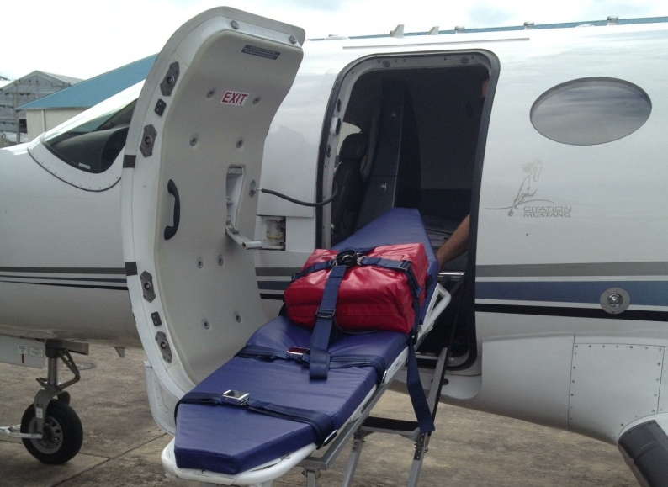
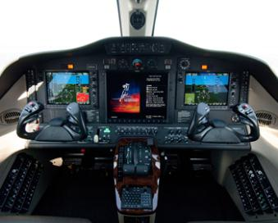
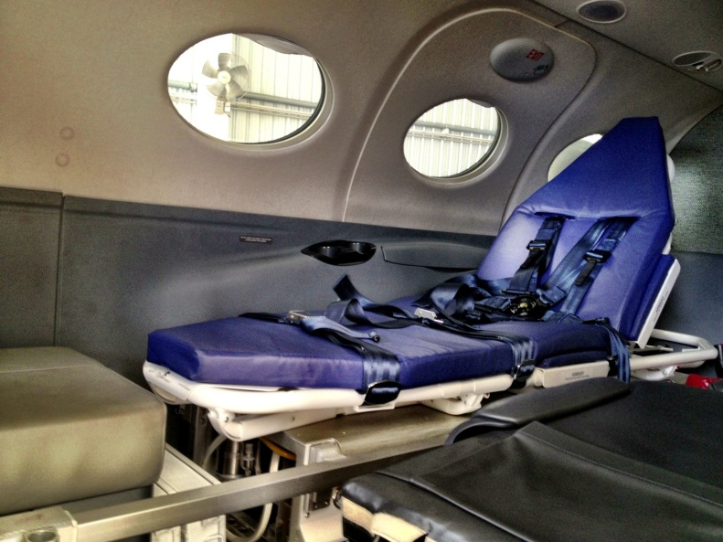
Our Life support system, stretcher and Avionics

Slide 8
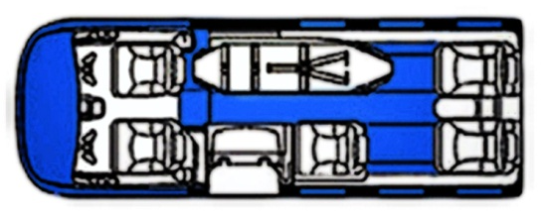

Slide 9
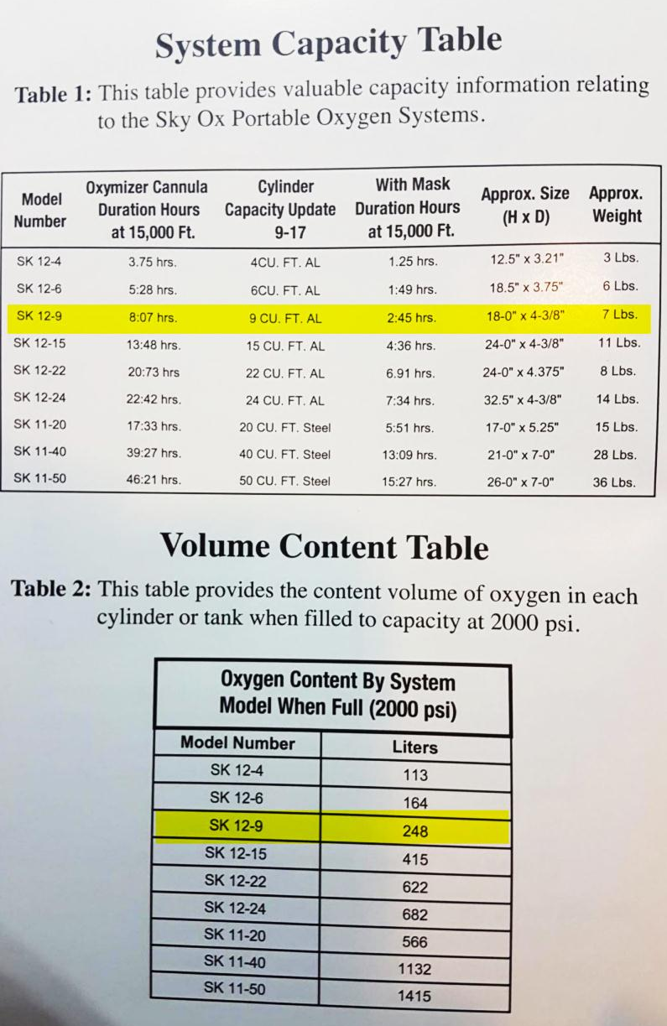
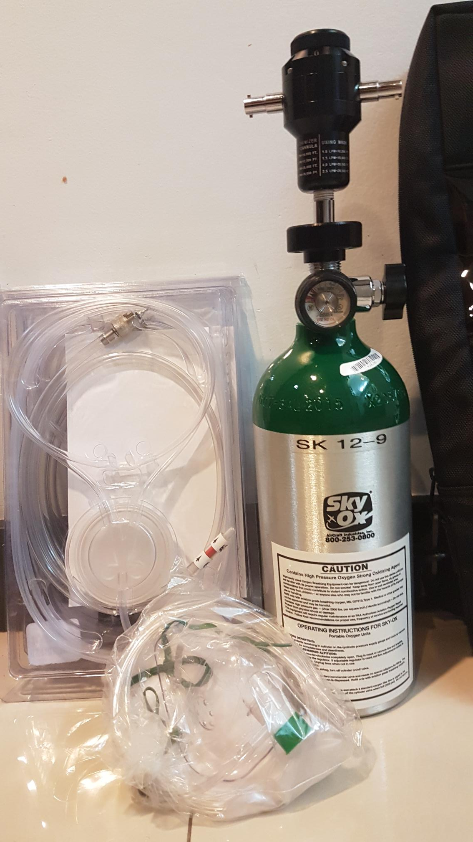

Slide 10
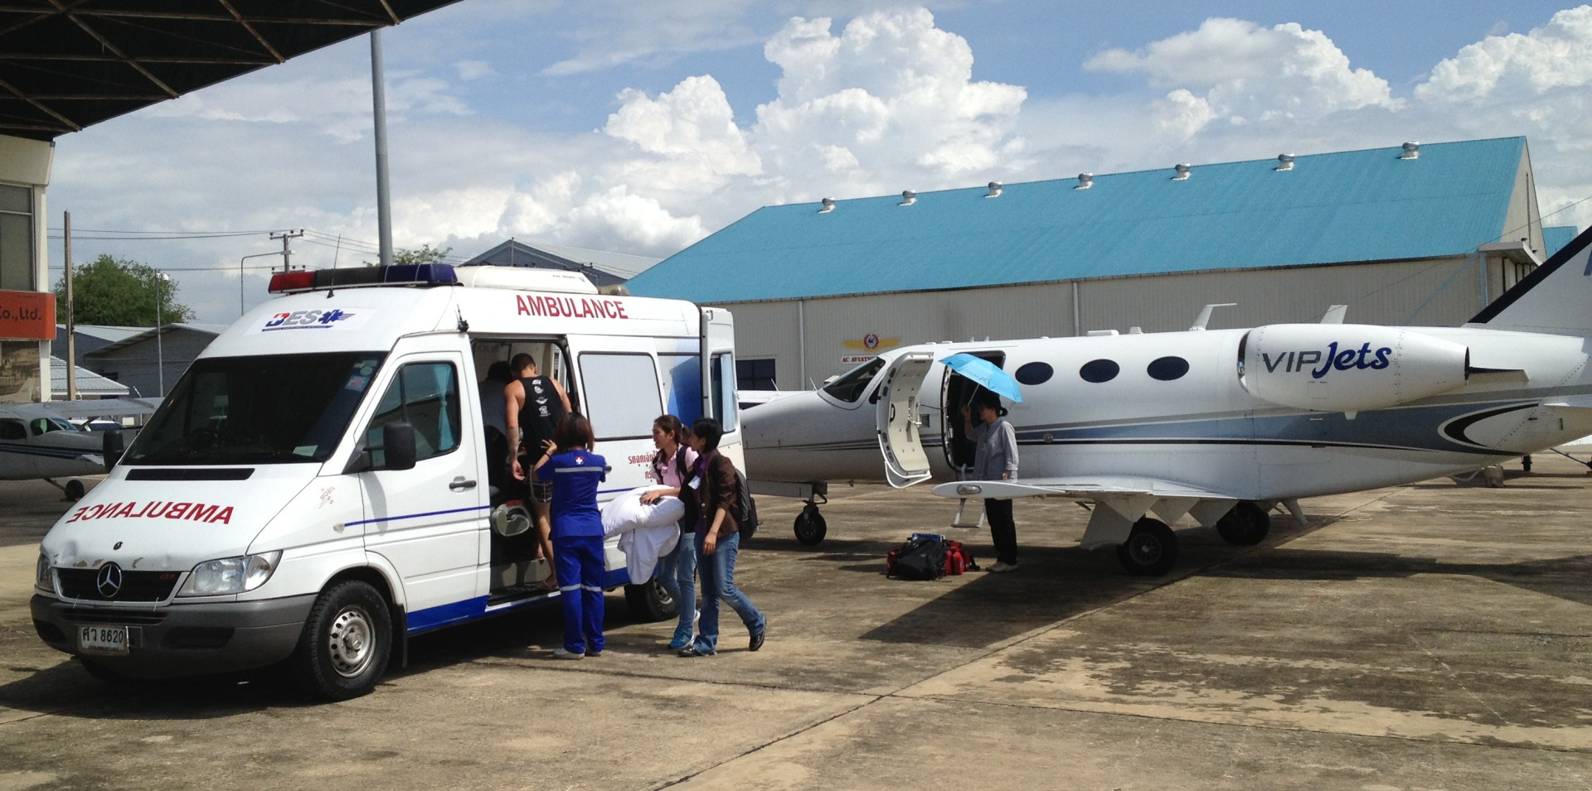

Slide 11
Easy access due to generous size of the aircraft’s door

Slide 12
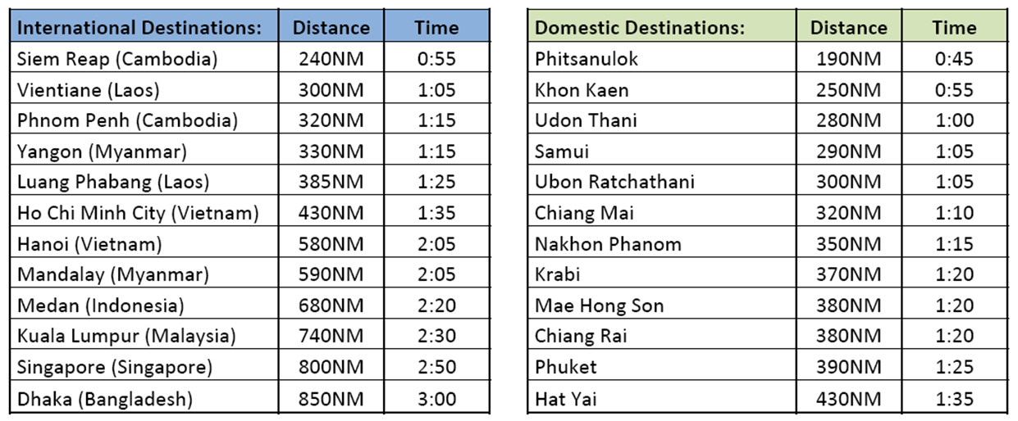
DESTINATIONS:

Slide 13
Range Circle – where can we take you “non-stop” from Bangkok?

Slide 14
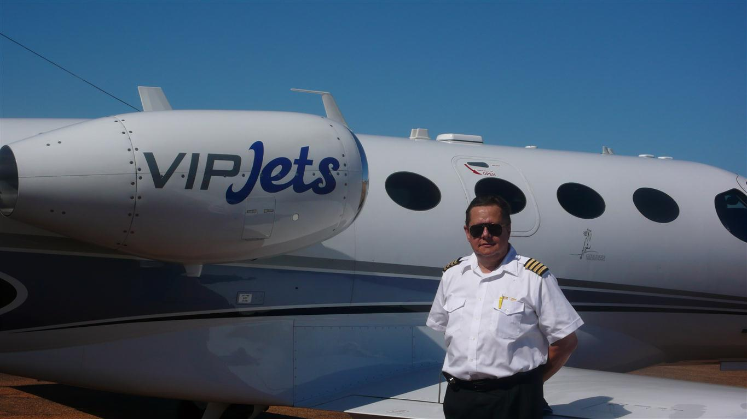
Professional Team!

Slide 15
VIP Jets will gladly submit you competitive quotes at short notice.
VIP Jets Ltd. www.vip-jets.net
Contact: vip@vip-jets.net matzig@vip-jets.net
fd@vip-jets.net

Slide 16
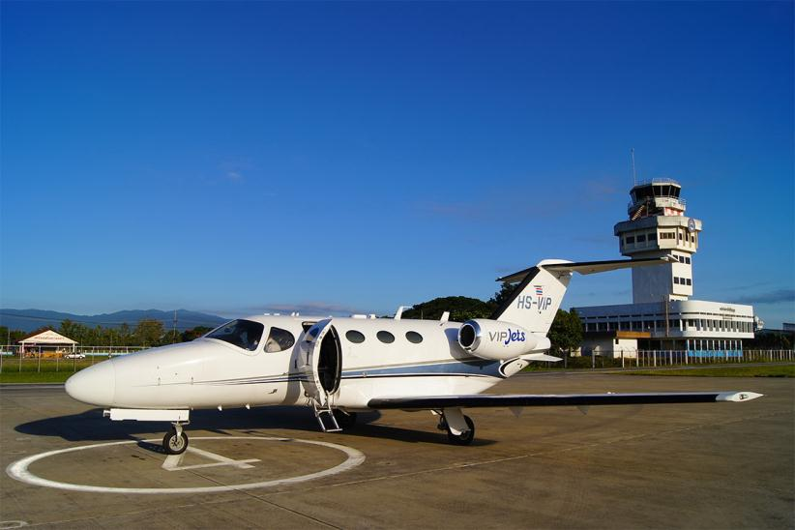
Thank you!

